Slide 1



Active Learning with Unbalanced Classes & Example-Generation Queries
Christopher H. Lin
Microsoft
Mausam
IIT Delhi
Daniel S. Weld
University of Washington

Slide 2
Suppose you want train a classifier to detect the sentiment of movie reviews.
Notes:
How would you do it?

Slide 3
How would you build a sentiment classifier?
Step 1: Download a million movie reviews
Step 2: Ask the crowd to label examples
Step 3: Train your favorite classifier
Pay: $0.01
Best
Crowd
Plaform
“This movie sucks!”
Favorable
Unfavorable
Notes:
Well, you might first download
Then you might

Slide 4
How would you build a sentiment classifier?
Step 1: Download a million movie reviews
Step 2: Ask the crowd to label examples
Step 3: Train your favorite classifier
Pay: $0.01
Best
Crowd
Plaform
“This movie sucks!”
Favorable
Unfavorable
Notes:
Now for step 2, you can’t actually ask the crowd to label every example unless you’re very rich.
So what do you do instead?

Slide 5
Step 2: Ask the crowd to label examples
Which examples?
Randomly sample examples
Active Learning
Notes:
Or you can do active learning, where you intelligently pick samples to label based on what your classifier says.

Slide 6
Active Learning
h
Uncertainty Sampling
[Lewis and Catlett (1994)]
Notes:
One of the most popular active learning

Slide 7
How would you build a sentiment classifier?
Step 1: Download a million movie reviews
Step 2: Ask the crowd to label examples
Step 3: Train your favorite classifier
Best
Crowd
Plaform
Pay: $0.01
“This movie sucks!”
Favorable
Unfavorable
Notes:
Now you’re good to go!

Slide 8
Suppose you want to train a classifier to identify sentences that talk about
“climate change”
(So you can figure out who to fire)
Notes:
But suppose right now,

Slide 9
Detect sentences about climate change?
Step 1: Download a million tweets
Step 2: Ask the crowd to label examples
Step 3: Train your favorite classifier
Best
Crowd
Plaform
Pay: $0.01
“Global warming is fake news”
Climate change
Not climate change
Notes:
Well you go and download a million tweets, and then ask the crowd to label them.
Except you can’t do that

Slide 10
The class skew is too high
P(tweet is positive for “climate change”)
0.0000000000001
Notes:
Because none of the sentences you have would talk

Slide 11
Detect sentences about climate change?
Step 1: Download a million tweets
Step 2: Ask the crowd to generate examples [Attenberg and Provost, 2010]
Step 3: Train your favorite classifier
Best
Crowd
Plaform
Please write a sentence about climate change
Global warming is fake news.
Notes:
So instead, what attenberg and provost suggested
For example you can ask the crowd to please write a.

Slide 12
Detect sentences about climate change?
Step 1: Download a million tweets
Step 2: Ask the crowd to generate examples [Attenberg and Provost, 2010]
.
Step 3: Train your favorite classifier
Please write a sentence about climate change
Best
Crowd
Plaform
Pay: $0.15 (REALLY EXPENSIVE)
Global warming is fake news.
Notes:
But the problem is that generating examples is really expensive, because this is a much harder task.
So you definitely should not _only_ generate examples

Slide 13
Detect sentences about climate change?
Step 1: Download a million tweets
Step 2: Ask the crowd to generate examples.
Step 3: Train your favorite classifier
Step 4: Ask the crowd to label examples
Step 5: Train your favorite classifier
Please write a sentence about climate change
Best
Crowd
Plaform
Pay: $0.15 (REALLY EXPENSIVE)
Global warming is fake news.
[Attenberg and Provost, 2010]
Notes:
In fact, what attenberg and provost showed, is that after generating a bunch of examples,

Slide 14
Detect sentences about climate change?
Step 1: Download a bunch of movie reviews
Step 2: Switch between labeling and generation.
Step 3: Train your favorite classifier
Step 4: Ask the crowd to label examples
Step 5: Train your favorite classifier
Please write a sentence about climate change
Best
Crowd
Plaform
Pay: $0.15
Global warming is fake news.
Notes:
But actually, we shouldn’t just switch from generation to labeling.
Ideally we should continuously re-evaluate what the best strategy is while we’re training the classifier.
And what the best strategy is heavily depends on the skew.

Slide 15
Detect sentences about climate change?
Step 1: Download a bunch of movie reviews
Step 2: Switch between labeling and generation.
Step 3: Train your favorite classifier
Step 4: Ask the crowd to label examples
Step 5: Train your favorite classifier
Our contribution
Please write a sentence about climate change
Best
Crowd
Plaform
Pay: $0.15
Global warming is fake news.
Notes:
And this is our contribution – to show how to build an algorithm that can switch between generating examples and labeling, and show that it’s better than existing baselines.

Slide 16
Question
Given a domain of unknown skew, how do we optimally switch between generation and labeling to train the best classifier at the least cost?
Notes:
So before we move forward, I want to compact all that motivation into a single question

Slide 17
Contributions
We present MC-CB, an algorithm for dynamically switching between generation and labeling, given an arbitrary problem with unknown skew.
We show MC-CB yields up to 14.3 point gain in F1 AUC over state-of-the-art baselines using real and synthetic datasets.
Notes:
And what are our contributions?

Slide 18
Best initial strategies
low skew
Labeling
high skew
Generation
What makes these strategies the best in their respective skew settings?
Notes:
Ok, so first I’m going to describe how
So we’ve already observed that labeling works perfectly well in low skew datasets,
But why is this true?

Slide 19
Best initial strategies
low skew
Labeling
high skew
Generation
What makes these strategies the best in their respective skew settings?
Cheap positive examples!
Notes:
It’s whichever strategy that can get you the cheapest positive examples!

Slide 20
Large factor in which strategy will work well is how cheaply they can obtain positive examples at any given time.

Slide 21
MB-CB (MakeBalanced-CostBound)
Computes the cost to obtain one positive example, and picks the cheapest method
Notes:
Using this intuition, we came up with MB-CB, an algorithm which works by computing the cost of obtaining one positive example from a given primitive.

Slide 22
MB-CB (MakeBalanced-CostBound)
Computes the cost to obtain one positive example, and picks the cheapest method
Generate Positive Example
Label Example
$0.15 per example
Notes:
Using this intuition, we came up with MB-CB, an algorithm which works by computing the cost of obtaining one positive example from a given primitive.
For example, if we set the price of generation to be $0.15, and the price of labeling to be $0.03, then

Slide 23
MB-CB
Cost to obtain one positive example
Generate Positive Example
Label Example
$0.15 per example
$0.15 for one positive
example
Notes:
If costs exactly $0.15 to get one positive example from generation.

Slide 24
MB-CB
Cost to obtain one positive example
Generate Positive Example
Label Example
$0.15 per example
$0.15 for one positive
example
$0.03 per example
Notes:
What about labeling?
Well, let’s suppose that we need to label 50 examples before we see one positive example.
But the problem is we don’t actually know
We just receive an observation everytime we execute this primitive.
So this is a reinforcement learning problem.

Slide 25
MB-CB
Cost to obtain one positive example
Generate Positive Example
Label Example
50 examples to get one positive
$0.15 per example
$0.15 for one positive
example
$0.03 per example
$1.50 for one positive
example
Notes:
Well in this case, MB-CB would choose to generate positive examples.

Slide 26
MB-CB
Cost to obtain one positive example
Generate Positive Example
Label Example
50 2 examples to get one positive
$0.15 per example
$0.15 for one positive
example
$0.03 per example
$0.06 for one positive
example
Notes:
But there’s only one problem here. MB-CB doesn’t know the expected number of times to

Slide 27
MB-CB
Cost to obtain one positive example
Generate Positive Example
Label Example
50 2 examples to get one positive
$0.15 per example
$0.15 for one positive
example
$0.03 per example
$0.06 for one positive
example
Reinforcement Learning Problem
Notes:
And so this is a reinforcement learning problem. The only way for MB-CB to learn

Slide 28
MB-CB adapts UCB from multi-armed bandit literature
Generate Positive Example
Label Positive
$0.15/positive
Observation
$1.50/positive
Lower
Confidence
Bound using UCB
$0.03/positive
Notes:
So what MB-CB does is, it adapts an algorithm, UCB, from the multi-armed bandit literature to do this RL
At the highest level, it maintains a lower confidence bound on the cost given the observations.
Then, it picks the primitive that has the lower cost to obtain one positive example.

Slide 29
MB-CB adapts UCB from multi-armed bandit literature
Generate Positive Example
Label Positive
$0.15/positive
Observation
$1.50/positive
Lower
Confidence
Bound using UCB
$0.03/positive
Lower confidence bound = average cost + w * #observations)
Notes:
Lower confidence bound is basically a weighted average of average cost so far and the number of observations we’ve made

Slide 30
Small detail
Every time MB-CB generates positive examples, it randomly samples examples from the unlabeled dataset and inserts them into the training set as negative examples.
Notes:
Now, there is a small detail that I’ve left out.
In high skew domains, this is perfectly fine – you get negative examples for free
In low skew domains, this is ok too, because you should be labeling.

Slide 31
How good is MB-CB, which dynamically switches between generation and labeling?
Notes:
Ok, so that’s the algorithm. How good is it?

Slide 32
MB-CB’s opponents
Round-Robin
Generate Positive Example* + Active Learning
GL (Guided Learning) [Attenberg and Provost, 2010]
Generate Positive Example*
GL-Hybrid [Attenberg and Provost, 2010]
Generate Positive Example*, then switch to Active Learning forever when derivative of learning curve is small enough
Active Learning
*Add 3 Random Negatives (free) per Generate [Weiss and Provost 2003]

Slide 33
The Unlabeled Corpus:
News Aggregator Dataset (NADS) [UCI ML Repo]
422,937 news headlines
  152,746 about Entertainment
  108,465 about Science and Technology
  115,920 about Business
  45,615 about Health
$0.03 per label
Notes:
From UCI machine learning repository. Gives us 4 domains in total.
Anytime we do active learning (uncertainty sampling), we sample from this dataset.

Slide 34
The Crowd Generated Examples:
NADS-Generate
1000 crowd-generated headlines for each topic:
Entertainment, Science and Technology, Business, Health
$0.15 per example
Notes:
We ask crowdsourced workers to generate examples of news headlines of each of the topics. We said they could generate it themselves or find them from any source.
Note The distribution of this could be totally different than the previous one (in fact it is totally different), much more realistic.

Slide 35
Experimental Setup
For each domain:
  For each skew in {1,9,99,199,499, 999}
    Set budget = $100
    Construct dataset from unlabeled corpus to target skew
    Compute F1 AUC for each strategy
    Average over 10 trials

Slide 36
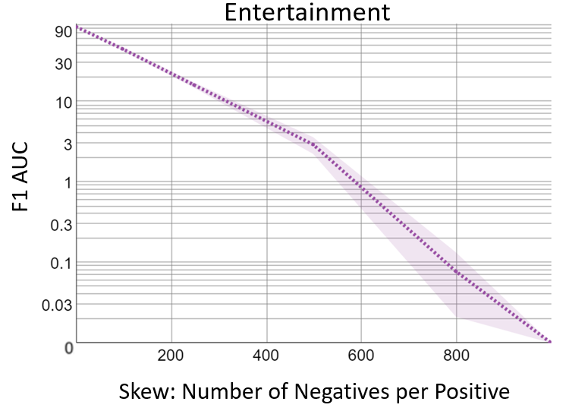

Entertainment

Slide 37
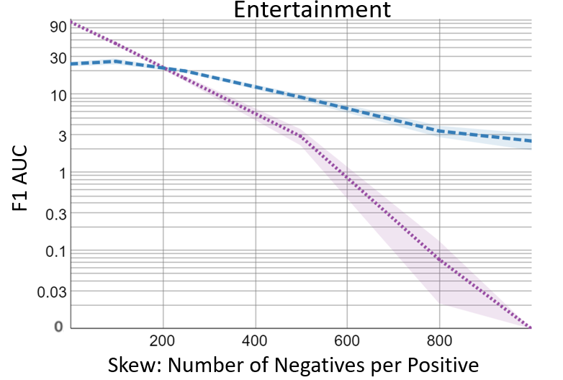

Entertainment

Slide 38
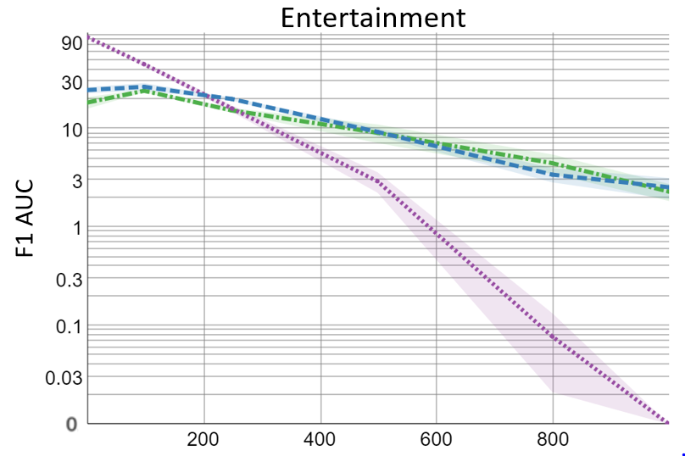

Entertainment

Slide 39
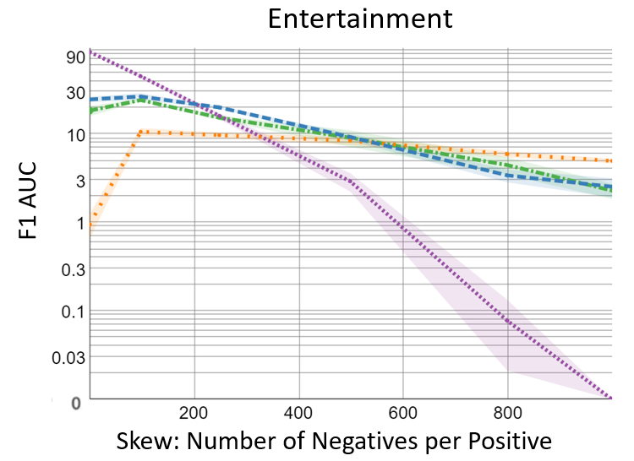

Entertainment

Slide 40
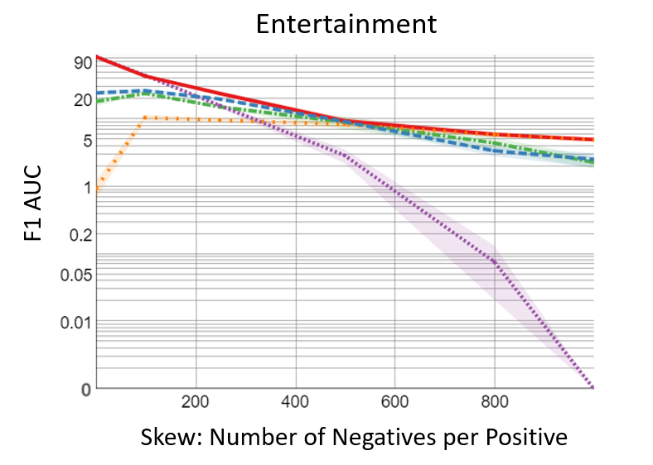
Notes:
First look at label-active

Slide 41
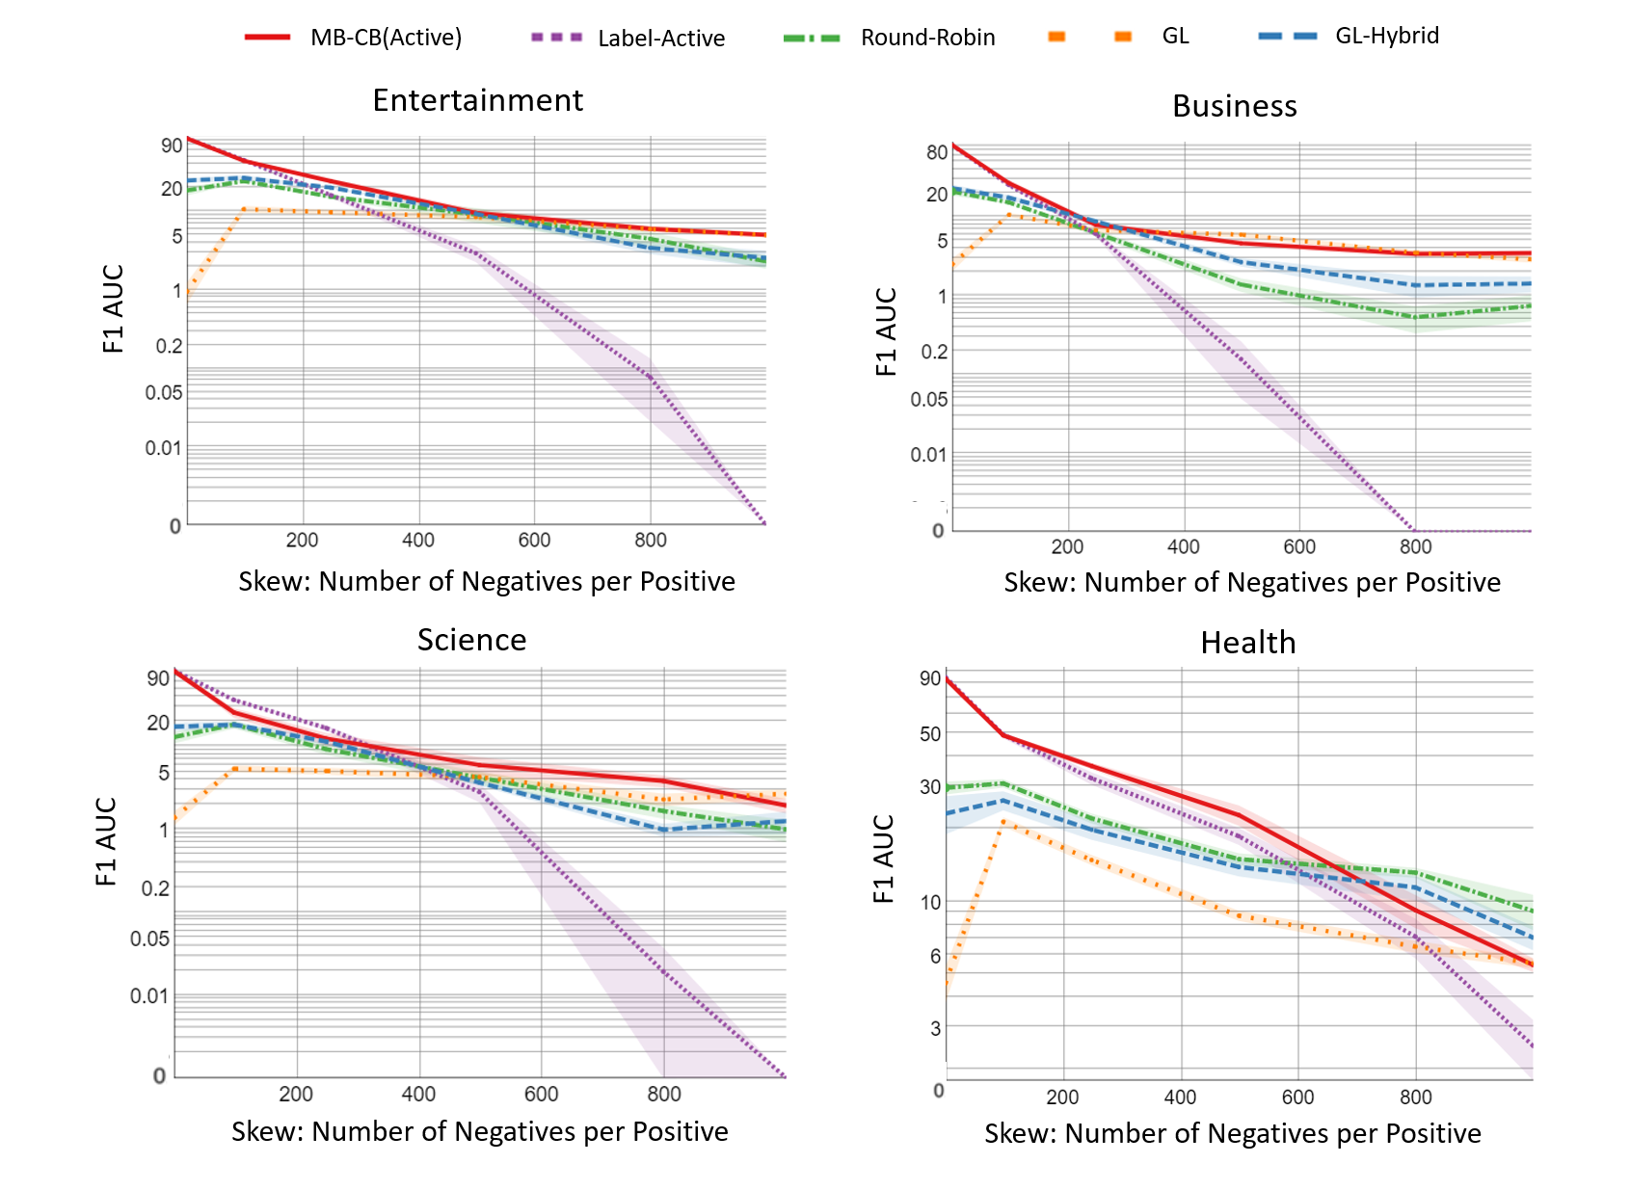

Slide 42
Extras in the paper
Notes:
Before I end,

Slide 43
More strategies for obtaining examples in paper
Notes:
We consider a bunch more strategies in the paper. For example, we ask workers to minimally modify positive examples to turn them into negative ones and we also consider a replacement for active learning.

Slide 44
What if instead of uncertainty sampling, we picked examples that we predict are positive?

Slide 45

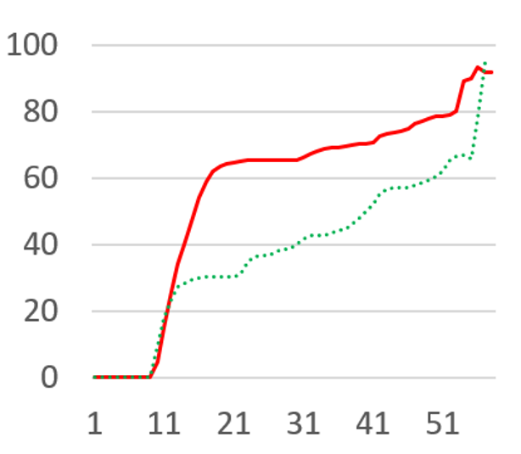
% of examples
That are positive
# examples in training set
Notes:
Well surprisingly that doesn’t work at all, because uncertainty sampling is actually better than positive exampling at getting positive examples at the beginning.

Slide 46
Takeaway
Use MB-CB to intelligently switch between positive example generation and labeling.
https://github.com/polarcoconut/thesis-skew

Slide 47
Questions?

